Slide 1
Agile Funding Fundamentals
October 2017
Notes:
SAY:
Welcome, introduce today’s trainers

Slide 2


Agile Funding Fundamentals
Agile Funding Business and Technology Leaders and Approvers and Coaches starting new initiatives using Agile Funding
This Agile Funding Fundamentals Workshop is designed to introduce Agile Funding. Coaching and continuous learning opportunities will be available after this session. This is not a deep dive into Agile principles or practices and ‘how to’ execute an Agile Funding initiative.
In person,
one day course
(8 hours)
Audience
Description
Duration
Describe Agile mindset and principles
Why Agile Funding and why now
Explain the difference between Traditional and Agile Funding
Understand key concepts related to Agile Funding
Objectives
Business Ideas and Scope
True North Metrics
Backlog Metrics
Describe the factors to determine the Agile Funding Rate
Explain how Agile Funding relates to Agile Principles
Notes:
SAY:
Audience
Description
Its about getting initial funding. It’s not about how to execute.
It’s not a deep dive on delivery. Both are important and will be addressed in other training.
Deeper dive into Agile principles or practices
In-depth 'how to' execute an agile funding initiative
Duration
Objectives
Three primary topics
What agile funding is
The history of agile funding – what got us here
Differences between agile and traditional funding

Slide 3

Knowledge Check
Using any web browser, respond at PollEv.com/agilefunding
This helps us understand your current knowledge of Agile Funding and better focus the course.
Notes:
SAY:
There are 24 questions. You have 10 minutes.
You can take the poll from your PC or smartphone. For either, enter the PollEV.com/agilefunding link in the browser.
You are taking this poll to 1) Provide us a baseline for what you know or how lucky you are at guessing 2) Help us assess the effectiveness of this workshop
We’ll repeat this test at the end.
DO:
Show the graph of the survey process

Slide 4
Agenda
Welcome &
Agile Funding
Introduction
Define
Business
Opportunity
Identify True
North Metrics
Prepare
Backlog
Ideas and
Metrics
Calculate
Monthly
Agile Funding
Rate
Agile Funding
Execution
Preview
Agile Funding
Fundamentals
Conclusion
120
40
90
60
40
20
55
minutes
minutes
minutes
minutes
minutes
minutes
minutes
15
45
15
Break
Lunch
Break

Slide 5
Ice Breaker
Pair up with someone you do not know.
Interview each other for two minutes.
Introduce your partner to the rest of the class for one minute.
Name
Role
Years with company
Share the NAME of a business opportunity that you’d like the group to work on with you.
Notes:
SAY:
If you are a table of three, one person needs to move to another table of 3.
DO:
After two minutes, say: Switch the interviewer and interviewee!
After two more minutes, say: Now we’ll go around the room and do introductions. Each of you will introduce your partner.

Slide 6
Agile Funding Introduction
120 minutes

Slide 7
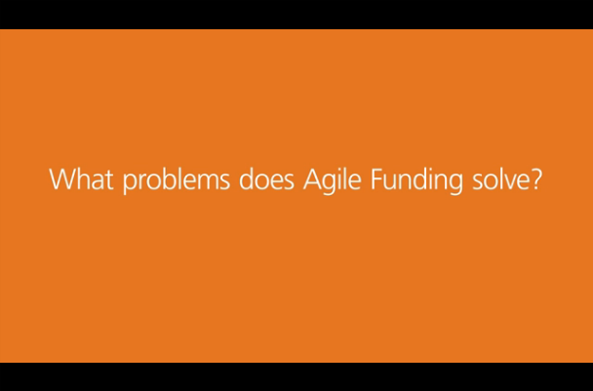
Testimonials
What problems does Agile Funding solve?
Notes:
SAY
These videos are available on HubConnect.
Thoughts, questions? What were some of the key points you heard during the video?
DO
After the video, close the video window to reduce use of system resources
Probing questions and comments:
What was striking about the video?
Mention that with Agile Funding you're not expected to have all the answers
Be smart from the start and understand that projects evolve
Agile funding acknowledges that you don’t know how much it’s going to cost.

Slide 8
Business Challenges Require Us to Re-evaluate
How We Do Business
We need to move faster and be more flexible.
We cannot predict the future.
We need funding that matches our delivery.
Our customers want new products and solutions quickly and expect us to adjust as the market changes.
Our competitors are using Agile practices to quickly deliver innovative solutions.
We need to be able to pivot as we learn.
When we assume we understand the problem and know the solution at the start of the initiative, we risk delivering the wrong thing at the wrong time.
Agile teams are embracing flexible requirements, iterative solution development, and change based on rapid, consistent customer feedback.
Our Traditional Funding assumes we know everything up front and encourages us to control, not embrace change.
Notes:
SAY:
We need to move faster and be more flexible. We are competing with other giants in the Healthcare industry but also big Tech companies such as Google and Amazon, we need to keep pace and be flexible
We cannot predict the future: Therefore we typically stick with solutions that have worked for us in the past. Not knowing whether an idea will work causes us to rely on things that have worked in the past, even if they may not add much value.
For example: Using the traditional IBM MQ solution because we know it well versus trying to come up with innovative ideas. What if we turn that on it's side....and say 'because we don't know what's going to happen...lets come up with various innovative ideas...try them out...if they work...Great!...if they don't work...let's pivot and try some of the other ones...and not lose a lot of money.

Slide 9
Agile Manifesto
We are uncovering better ways of funding initiatives developing software by doing it and helping others do it. Through this work we have come to value:
Agile Manifesto
Agile Funding Manifesto
Individuals and interactions
  over processes and tools
Judgment and thinking
  over processes and approval checklists
Working software
  over comprehensive documentation
Value delivery
  over cost justification
Customer collaboration
  over contract negotiation
Customer collaboration
  over requirements handoff and inspection
Responding to change
  over following a plan
Responding to change
  over approving change controls
While there is value in the items on the right, we value the items on the left more.
9
9
Notes:
Spend 1 minute explaining agile manifesto. Mention: these points will be reinforced throughout the day.
SAY:
Agile development is a term that was derived from the Agile Manifesto, which was written in 2001 by a group that included the creators of Scrum, Extreme Programming (XP), Dynamic Systems Development Method (DSDM), and Crystal; a representative of feature-driven development; and several other thought leaders in the software industry. The Agile Manifesto established a common set of overarching values and principles for all of the individual agile methodologies at the time. The manifesto details four core values for enabling high-performing teams.
Individuals and their interactions
Delivering working software
Customer collaboration
Responding to change

Slide 10
Agile Funding Guiding Principles
Speed to value is an early indicator of long-term program success
Emphasize learning, adapting to new information, and remaining open to all options
Value can be realized through both business process and technical solutions
Tying results back to True North Metric realization is most important
Ensure that funding allocations cover a strategic mix of short and long-term backlog ideas
Demonstrate to the Capital Committee that your initiative can deliver value
Collaboration and competition return value to the business
Transparency enables informed decisions throughout the process
Notes:
NOTE:
Animated slide.
SAY:
Speed to value: - Typically successful projects have been those that have returned value quickly. Those that we had to 'wait for value'…we typically ended up waiting a long time and they never returned value. If the program does not show planned progress or slows down from a strong start, a change in direction or cancellation is required.
Learning, adapting to new information….: “Let’s make this a conversation”
Business process and technical solutions: Being able to pivot from being IT centric to business centric. Ideas that are business oriented often have quick, high returns. When we STOP being Technical and Solutions focused, the Business team comes back with changes in Business Process that typically add significant value. Example: Business partners usually maintain a list of small enhancements (typically around $10k or so) and would package them into a larger initiative somewhere down the line. Agile funding ends that. We can go at those small enhancements that add incremental value as soon as they're identified.
Funding allocations cover a strategic mix: With agile funding we like having a 50/50 split between short term and long term items that add value. Don’t lose sight of long term goals by only preferring short, quick returns. For example: if you receive 500k dollars in funding, in general no more than 50% should be allocated to long-term value.
Demonstrating to Capital Committee: The approach is not “I need this much” the approach is now “I want to deliver values in these ways….” It’s all about building trust with them. The company dollars are being spent strategically and are returning value sooner.
Collaboration and competition: the notion of competing ideas. In the Traditional way, 2 people bring up 2 different ideas and argue over which one is better...the loudest person typically won. With AF, we take the approach that we will work on both of those ideas and 'Pivot' after we get more information (testing your theories). This is a Healthy way of looking at things. Do both, then use facts to determine what works. Lose the mindset that if your idea fails you will get fired.
Transparency - Showing everyone everything. The idea of constant visibility on what's going on (what's working, not working, where are we getting value, where are we not, etc.). This way programs can fund themselves and stand on their own.

Slide 11
Agile Funding
(0-3 month launch)
(Every 3-9 months)
Initial Funding Review
Execution
Review
Pre-funding
Preparation
Agile Delivery
EXIT
EXIT
Notes:
SAY:
This workshop is about the first part of the bottom image, from 0-3 months, and the last part (execution reviews) every 3-9 months.
Initial Funding Review: Capital committee evaluates proposal and decides whether to fund
Executive Review: Capital committee evaluates initiative performance, AND Continue, change funding level, or end
The middle part, referred to as the hamster wheel, we know how to do…this is the Agile process where Scrum teams are working on the backlog items and delivering value.
It’s important that the execution teams/Scrum teams remain aware of the Agile Funding True North Metrics and Backlog Metrics so that they can figure out ways to measure progress and get ready for those execution reviews

Slide 12
Must-Know Key Terms
Business Opportunity
True North
N
Agile Funding Rate
$
$
!
True North Metric
Value
Risk
Backlog Metrics
Backlog Ideas
Notes:
SAY:
This is the road that will lead to business opportunity
Backlog Ideas are what you are going to do/implement, how you are going to get to the business opportunity at the end of the road. These are the ideas of how you’re going to get to the business opportunity.
Backlog Metrics are the measurement of the value provided by the Backlog Idea or group of ideas.
True North ensures you are headed in the right direction, it’s the direction an initiative needs to go in order to maximize the value from the initiative. There can be more than one true north for a given Business Opportunity. You establish true north once you have an idea of the opportunity. Examples include: Increase revenue, decrease operating or benefit expense, increase NPS (net promoter score)
True North Metric ensures you have ways to measure the value, it is the measurable result of success for the initiative. However, the True North Metric may not be directly measurable, but instead measured through its Backlog Metrics. It is used to evaluate the success of the results of an initiative on its journey to completion and toward value. The metric is how you measure progress against the true north goal. Also, there can be multiple metrics for a business opportunity. It is the target for True North or the from/to. Example: Decrease operating expense by 7% from $100M to $93M by mid-2018.
Agile Funding rate is the monthly rate of funding for cumulative Backlog Items that demonstrates continual delivery of value. Always subject to change with direction and approval from the Capital Committee. This is a calculated value for program funding.
Business Opportunity is a scope of value. It is the territory where we are hunting for value. The value itself can be business, customer, market or internally focused.

Slide 13
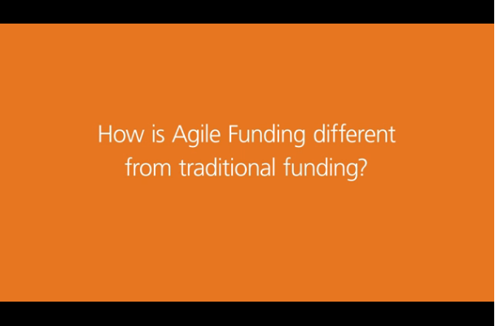
Testimonials
How is Agile Funding different from Traditional Funding?
Notes:
SAY
These videos are available on HubConnect.
Thoughts, questions? What were some of the key points you heard during the video?
DO
After the video, close the video window to reduce use of system resources

Slide 14
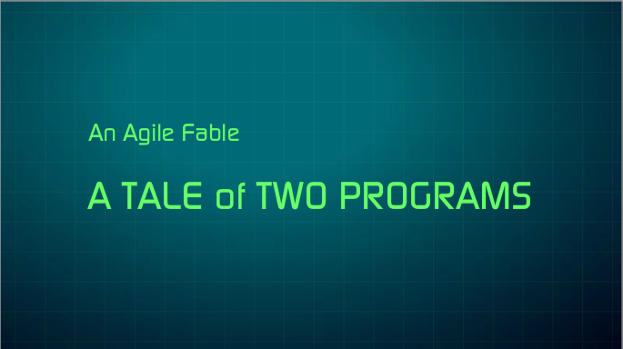
A Tale of Two Programs
Notes:
SAY
These videos are available on HubConnect.
Thoughts, questions? What were some of the key points you heard during the video?
DO
After the video, close the video window to reduce use of system resources

Slide 15
What Funding Works Best?
Traditional Funding works best when
Agile Funding works best when
Waterfall (traditional funding): The program is fully estimated, planned, and funded for its duration.
Key measures are established, an initial funding rate is set, the program executes iteratively, and is quickly evaluated for progress.
Requirements are known, stable and/or externally determined (e.g. ICD10, HIPAA 5010, fixed contract with customer)
Integrations, Mergers and Acquisitions (M&A) activities (e.g. Orca)
“Big Bang” projects (Freshstart), where dates are certain and requirements are management calls
Small projects with fixed deliverables
Waterfall or agile delivery methods are used
Enhancements for single/simple product set with stable delivery cadence
Problem and/or solution is uncertain
Scope is large, complex, and/or changing quickly
Learning is required to determine how best to meet the desired business goals
Agile delivery methods are used
Value can be created in short, continuous cycles
Examples:
Rapidly changing business environments (portals, start-ups, innovative technology solutions)
Enhancements to existing systems (eMBI, Accumulators)
Deploy and build on MVP (Issue Management and Client Source of Truth)
Notes:
SAY:
Regulatory compliance projects can be either traditional or agile. It depends on how stable the requirements are and how flexible Optum can be with the solution.
Agile Funding Example, accumulators was a good fit for Agile Funding because we had some flexibility around how to define the problem and the extent it could be solved.
Traditional Funding Example, IC10 had fixed requirements and a defined end date. Another traditional funding example: Fresh Start. On 12/31, no users were live. The next day, 1/1, 100% of the users were live.
Not every M&A project or Regulatory project needs to go Traditional
Agile Funding projects will always need to use Agile development.
You cannot be Agile funded and managed as Traditional.
We need to be careful about too much up front planning and too much detail - we don't want to spend too much time just planning. Agile Funding encourages teams to tackle risky things up front, get started now, learn as you go, and pivot as needed.

Slide 16
Funding for Traditional and Agile Programs
When new learning and initial assumptions don’t hold true
“Oh &%*&I&^ Return to Capital Committee.”
Traditional Funding
The program is fully estimated, planned, and funded for its duration, and many estimates are “negotiations.”
When new learning and initial assumptions don’t hold true
“Oh well, we will change the backlog.”
Agile Funding
Key measures are established, an initial monthly Agile Funding Rate is set, the program executes iteratively, and is quickly evaluated for progress.
Notes:
SAY:
Traditional Funding was not tied to value. Everything was scoped out ahead of time.
We need to show progress against our goal. Let’s find a business metric (Reduction in accumulators) and then down the road it has a financial metric that kicks in.
Some assertions are accurate, while others are not. True North Metrics/assertions are flexible to allow business and technology partners to come up… with something that is successful.
Agile Funding – we’re looking for key measures of success.
Juan’s comment on this slide: n/a - From my perspective this slide seemed like an overkill….because the previous slides and videos spoke about this content

Slide 17
Agile Funding Governance
Traditional Funding
Approves Total Funding Request
Approves Requirements Analysis
Approves Scope and Approach
Reviews/approves Change Requests
Capital Committee
$$$
Agile Funding
Approves Business Opportunity and True North Goal
Approves Monthly Agile Funding Rate
At each Execution Review, reviews Value Delivered and potential Backlog Ideas
Approves continuation, change, or cancellation of funding
Notes:
SAY:
We normally function as “side of desk” [side of the desk = part-time business involvement]. As a project manager, we only spend 25% of the time on the project. With Agile you need someone dedicated. It’s a change management piece that Agile projects need more funding.
The role of the capital committee in Traditional Funding is to approve the entire project. In Agile funding the role is much different. They are approving your true north and your funding rate – that’s it. At the review, the capital committee approves any change of direction, any change in funding rate, or kills off the project (maybe it isn’t providing value, or maybe it has completed it’s ability to provide value!).

Slide 18
Agile Funding Governance (continued)
Traditional Funding
Meets the approved scope within the approved budget
Measures project delivery (scope, cost, time)
Submits change requests as needed
Business and Technology Team
Agile Funding
Owns the scope (add, change, or cancel Backlog Ideas)
Measures value created via Backlog Metrics
Recommends funding changes based on progress and learning
Notes:
SAY:
Very important: The business team owns the backlog of ideas, not IT. The backlog of ideas is not limited to technical solutions.

Slide 19
Agile Funding Governance (continued)
Program Governance
Define Backlog Ideas to promote
Capital Governance
Review targeted value, initial Backlog
Review Agile Funding Rate
Program Governance
Review progress
Determine Backlog Ideas to promote
Align Backlog Metrics to True North or intervene
Capital Governance
Review Backlog Performance Report
Assess future Backlog of Ideas
Validate/update/terminate funding rate
Technical Execution
Remove blockers for team
Define roadmap
Define business / technical guardrails for backlog
Technical Execution
CA Agile Central
IRAAD
Financial Management
(0-3 month launch)
(Every 3-9 months)
Initial Funding Review
Execution
Review
Pre-funding
Preparation
Agile Delivery
EXIT
EXIT
Notes:
NOTE:
Animated slide.
Font is small and may not be ledge able when projected. Facilitator must refer to 1 pager.
SAY:
This is agile funding from A to Z at the big picture level.
Walk through all the boxes color by color, relating them to the timeline in the bottom graphic.
Potential idea backlog: Realize that once you get the approval for funding, the potential idea backlog can be thrown away if analysis shows you better ideas .The potential ideas backlog serves to prove you have something worth considering. You come back with backlog performance review at the executive review. At that revew the key is are you unlocking enough potential to keep going? Or did you unlock all the value you can get?
DO:
Facilitate a dialog with the group on any questions

Slide 20

Lessons Learned
Adopting Agile Funding is a change in behavior and a significant change management effort to make it successful
Traditional Funding can be a barrier to effective realization of the full value of Agile Delivery
Agile Funding requires focused, sustained involvement from the business
Notes:
SAY:
Make sure the correct problem is being solved.

Slide 21
Define Business Opportunity
40 minutes
Notes:
45 minutes allocated for Business Opportunity and Scope:
1 Activity – 10 minutes
1 Poll Everywhere – 3 minutes
5 content slides – 32 minutes

Slide 22
Agile Funding
You are here
(0-3 month launch)
(Every 3-9 months)
Initial Funding Review
Execution
Review
Pre-funding
Preparation
Agile Delivery
EXIT
EXIT
Notes:
SAY:
This workshop is about the first part of the bottom image, from 0-3 months, and the last part (execution reviews) every 3-9 months.
Initial Funding Review: Capital committee evaluates proposal and decides whether to fund
Executive Review: Capital committee evaluates initiative performance, AND Continue, change funding level, or end
The middle part, referred to as the hamster wheel, we know how to do…this is the Agile process where Scrum teams are working on the backlog items and delivering value.
It’s important that the execution teams/Scrum teams remain aware of the Agile Funding True North Metrics and Backlog Metrics so that they can figure out ways to measure progress and get ready for those execution reviews

Slide 23
Agile Funding Process – Define Business Opportunity
Define Business Opportunity
Prepare Backlog Ideas and Metrics
Identify True North Metrics
N
Value
Determine Agile Funding Rate
Notes:
SAY:
These steps move in a clockwise direction, and are an iterative, continuous cycle.
Scrum teams need to understand the cycle to help prepare themselves for capital reviews
Notice that they all intersect in value.
Value is the nexus.

Slide 24
Knowledge Check
You need a fully defined Business Opportunity before you can define your True North Metrics and Backlog Metrics.
Yes
No
Notes:
SAY:
Why did you say Yes?
Why did you say No?
Answer is NO. It’s an iterative process.

Slide 25
How Do You Identify the Business Opportunity?
Agile Funding focuses on determining the Business Opportunity (Scope of Value) versus the Scope of Work
Scope of Work leads to the dutiful completion of requirements or requests
A Scope of Value focuses on outcomes:
  Business related
  Market related
  Customer related
  Internal audience related
The Business Opportunity is the territory where we hunt for value.
Describe the mountain:
What mountain are you climbing?
How big is the mountain?
Where is the mountain?
How big is the opportunity landscape?
How big is the opportunity in dollars?
Notes:
SAY:
Make sure the correct problem is being solved.

Slide 26
Examples

Slide 27
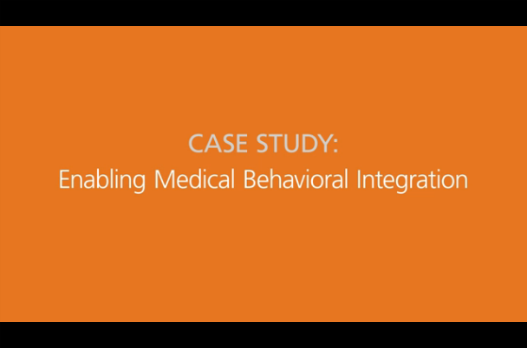
Testimonials
Case Study: Enabling Medical Behavioral Integration
Notes:
SAY
These videos are available on HubConnect.
Thoughts, questions? What were some of the key points you heard during the video?
DO
After the video, close the video window to reduce use of system resources

Slide 28

Example: Agile Funding Request – eMBI Program
(Enabling Medical Behavioral Integration)
Our approach to managing the health of our members is to integrate behavioral care information as broadly as possible across care providers. This approach relies heavily on integrated identification and stratification of member populations, integrated consumer engagement across all touch points with interventions designed specifically to meet the challenges posed by medical and behavioral conditions and the complications of comorbidity.
Business
Opportunity
Scope
  Integrate/share clinical processes across medical and behavioral health teams; internally and externally
  Integrate clinical data collection, clinical case assessment, multi-disciplinary care and treatment planning
  Create ability for cross-team communication and close communication with both primary care and behavioral health care providers
  Develop integrated interventions tailored to meet the needs of each condition and the complications brought by comorbidity
Notes:
SAY:
Ask learners to identify areas for improvement and recommendations.
Ask learners to explain the key difference between Business Opportunity and scope.
Additional Scope:
Develop integrated engagement across medical, behavioural, pharmacy and other touch points and use screening and other identification techniques broadly
Improve the ability to identify and stratify members based on the level of need; across medical, behavioural, pharma, etc. identify consumers by need
Develop population-level metrics that incorporate all aspects of the member’s health possible across the continuum to move a member towards healthier

Slide 29
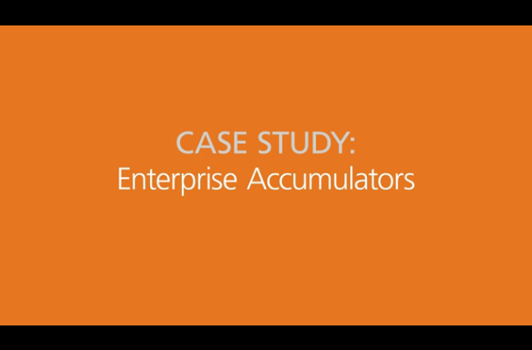
Testimonials
Case Study: Enterprise Accumulators
Notes:
SAY
These videos are available on HubConnect.
Thoughts, questions? What were some of the key points you heard during the video?

Slide 30
Example: Enterprise Accumulator Program Overview
Develop an enterprise solution to comply with the Affordable Care Act (ACA) requirement for an annual Maximum Out of Pocket (MOOP) by member/family for Essential Health Benefits (EHB) and improve member experience. Current Accumulator process is inefficient and error-prone, consisting of point-to-point data connections and significant manual work. Program will leverage UHC Accumulator Hub to deliver a scalable, efficient and accurate solution to enable sharing across Medical, RX, Behavioral, Dental, Vision & Physical Health and comply with the ACA requirement enterprise-wide. Furthermore, it will mitigate financial and reputational risks associated with current error-prone accumulator processes.
Business
Opportunity
Scope
  Accurately process and communicate Accumulator dollars to ensure members do not incur costs beyond their MOOP limits
  Improve ability to identify and analyze root cause of Accumulator errors and Refund checks
  Improve operational efficiencies across benefit sharing partners by process improvements including benefit compare/QA, eligibility setup, policy plan setup/synchronizing, member mismatch etc.
Notes:
SAY: Ask learners to identify areas for improvement and recommendations.
Additional Scope:
Enable accumulator sharing across medical, behavioral, pharmacy etc. to support increasingly complex benefit deals/configurations
Store all Accumulator data centrally in the Data Lake to enable root cause analysis, business self-service reporting, and analytical capability
Build standardized connections between Accumulator Hub for UHC, RX and Behavioral claims engines and their external payers/partners

Slide 31
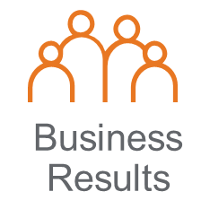
Agile Funding Pilot Summary
$13.9M Capital Giveback
$10.4M Value to Date
25.6% Year-over-year Refund Check Reduction
$7.2M Value to Date
79% IRR (Internal Rate of Return)
Accumulators
eMBI
Client
Source of
Truth
Cost Savings/Avoidance ($22.7M)
Notes:
SAY:
Agile software delivery has a proven track record in our company.
IRR (internal rate of return) is a financial metric used in capital budgeting to estimate the financial return of an investment. The resulting percent is the rate of return of the program, when the net present value of cash flows (both positive and negative) from the investment are equal to zero. This percent must be compared against a threshold and if it exceeds that threshold, the program is financially viable.

Slide 32
Case Study Activity

Slide 33
Case Study Inputs 1
You manage the call center for the Health Savings Account (HSA) business. Ten percent of the calls that come into the helpdesk are driving 40% of the cost. If you can figure out a way to decrease the call time for the longest calls, you can drive significant expense reduction in your area.
Initial analysis of the calls indicates that the majority of the long calls have the following characteristics:
Call topics required the agent to perform extensive searches through a SharePoint site of unstructured, unindexed, and uncategorized documents.
Agents with less than a year experience were twice as likely to have long calls than agents that had been there over a year. Currently, all agents work out of the same queue, regardless of experience level.
Current Landscape
Average call length is 10 minutes, with 90% of the calls lasting less than 15 minutes.
The remaining 10% of the calls range from 15 to 45 minutes.
Expense break-down
Every call costs $2 per minute.
User counts
Each weekday the call center handles 3,000 calls.
Your mission
You have 5 minutes.
List ideas for Business Opportunity statements (Elevator Pitch) on your flipchart.
Avoid solutioning or defining True North Metrics.
Notes:
You have 10 minutes and a flipchart for your table.
If struggling, hypothesize what the True North Metrics could be.

Slide 34
Case Study Inputs 2
Your business segment has identified a new opportunity within the Employer Paid health plans market. Employers want to track the effectiveness of their campaigns to encourage employees to exercise. The exercise campaign will be conducted by a third party, but the employers want an independent party to track their engagement rates using data uploaded from wearable devices.
The business segment has done market research and found an emerging opportunity based on leveraging existing fitness apps, e.g., “Map My Run,” to pull data and aggregate them into a single portal.
This approach provides quick speed to market and low initial investment.
The disadvantage is long term support costs as constant updates to the aggregation system are required to keep up with changes in the third party fitness apps.
Current Landscape
25 large employers have shown willingness to pilot this program, but only if the first six months are free.
Profit Margin
Employers are willing to pay around $2-$5 per member per month.
User counts
The 25 employers interested in the pilot average 3,000 employees each.
Your mission
You have 5 minutes.
List ideas for Business Opportunity statements (Elevator Pitch) on your flipchart.
Avoid solutioning or defining True North Metrics.
Notes:
You have 10 minutes and a flipchart for your table.

Slide 35
Case Study Recommendations
  Your mission:
  List ideas for Business Opportunity statements (Elevator Pitch)
  Avoid solutioning or defining True North Metrics
Table 1
Table 2
Table 3
Table 4

Slide 36
Identify True North Metrics
90 minutes

Slide 37
Agile Funding
You are here
(0-3 month launch)
(Every 3-9 months)
Initial Funding Review
Execution
Review
Pre-funding
Preparation
Agile Delivery
EXIT
EXIT
Notes:
SAY:
This workshop is about the first part of the bottom image, from 0-3 months, and the last part (execution reviews) every 3-9 months.
Initial Funding Review: Capital committee evaluates proposal and decides whether to fund
Executive Review: Capital committee evaluates initiative performance, AND Continue, change funding level, or end
The middle part, referred to as the hamster wheel, we know how to do…this is the Agile process where Scrum teams are working on the backlog items and delivering value.
It’s important that the execution teams/Scrum teams remain aware of the Agile Funding True North Metrics and Backlog Metrics so that they can figure out ways to measure progress and get ready for those execution reviews

Slide 38
Agile Funding Process – Identify True North Metrics
Define Business Opportunity
Prepare Backlog Ideas and Metrics
Identify True North Metrics
N
Value
Determine Agile Funding Rate

Slide 39
Knowledge Check
True North Metrics must always have a dollar value.
Yes
No
Notes:
Answer: No. NPS does not have a dollar value.

Slide 40

Family Vacation

Slide 41
What is True North?
True North is the direction an initiative needs to go to maximize the value from the initiative.
A True North Metric
Is the measurable result of success for the initiative.
May not be directly measurable, but instead measured through its Backlog Metrics.
Is used to evaluate the success of the results of an initiative on its journey to completion and toward value.

Slide 42
True North Provides Focus
True North is why we care – clearly aligns the team to a purpose.
True North is the direction an initiative needs to go to maximize value.
True North Metrics will grow as we recognize other ways to categorize value.
True North Metrics do not need to be directly measurable. However, they need to have Backlog Metrics that are.
True North Metrics are not the sum of the Backlog Metrics.
Not all True North Metrics are valued monetarily.
Although the Agile Funding Calculator only uses the monetary True North Metrics, the non-monetary True North Metrics will be considered for the Agile Funding Rate as well.
Provides focus in climbing the mountain:
Are we doing the right things?
Does our backlog provide the value we want?
Can we measure Backlog Item success against True North?
N

Slide 43


Characteristics of True North
What it is
What it isn’t
An expression of value
Restricted to monetary value only
Focuses team on the value proposition
Restricted to a list of categories
Evolves based on new learning
Set in stone at the start of the initiative
Big picture and business focused
Limited to the sum of the Backlog Metrics

Slide 44
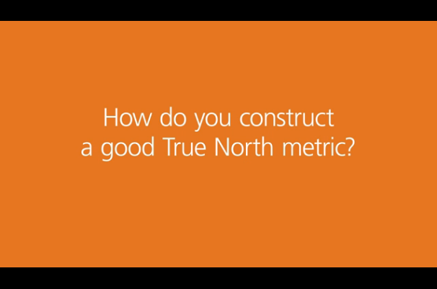
Testimonials
How do you construct a good True North Metric?
Notes:
SAY
These videos are available on HubConnect.
Thoughts, questions? What were some of the key points you heard during the video?
DO
After the video, close the video window to reduce use of system resources
NOTE:
You may eventually need 10 MM but you don’t need it now. Take 100K now and get started, learn and create value.
If you take more than you need you are preventing other projects from using the money. The Capital Committee will likely question why you took more money than you needed.

Slide 45
Starting to Refine Your True North: An Iterative Process
Review your Business Opportunity.
Identify the value categories related to your ideas.
Revenue - All Channels (Payer, Employer, Medicaid, Federal)
Win Rate – All Channels
Consumer NPS
Operational Expense
Benefit Expense
Identify at a high level how your Business Opportunity contributes to each category.
What is the magnitude of the value? The Capital Committee provides funding in exchange for your commitment to improve your True North Metrics.
Identify the imagined end state that creates the value. Adjust your Business Opportunity.
Your True North Metrics might uncover additional definition or refinement of your scope
You might identify additional ideas to pursue
Notes:
SAY:
Define NPS by small, medium or large impact.

Slide 46

Anatomy of a True North Metric
Decrease operational expense
By 7% from $551MM in 2016 to $510MM by mid-2019
Sets direction and focus
Team aligns efforts to meeting the objective
Identifies time period for results
2016 to mid-2019
Quantifiable and monetary
$551M to $510M
Readily apparent and visible
Based on operating expense reporting
Uses a major category used in the Agile Funding Calculator
SG&A Benefits
Easy to understand
Includes the “what” ($510MM) by “when” (mid-2019)

Slide 47
True North? Yes or No?
Improve Claims Management Process by implementing APIs
Increase payer revenue
Reduce number of manual refund checks
Improve organization’s technology footprint by reducing the number of issue management systems
Notes:
NOTE:
Animated slide. Click to reveal the question.
Learners should raise their hand to indicate if it is a True North Metric.
Payer revenue and refund checks are good examples.
APIs and reducing issue management systems are bad examples.

Slide 48
Workshop Example and Large Group Discussion

Slide 49
True North Metrics
Revenue-based Examples of True North
Cost Reduction-based Examples of True North
NPS-based Examples of True North
Other Examples of True North
Increase Net Revenue through increased line of sight into client’s total portfolio resulting in incremental upsell and cross-sell opportunities.
Revenue Retention through improved ability to identify, forecast, and execute successful client renewals, reduce implementation cancelations, and improve win-rate.
Reduce operational expense by increasing the IVR authentication rates.
Reduce ongoing infrastructure cost (disks & CPU utilization).
Increase the number of members utilizing the member portal monthly.
Reduce the percentage of orders that take more than six days from order to delivery.
Increase scalability and accessibility of the platform.
Reduce IVR call handle time.

Slide 50
eMBI True North Metrics
True North Metrics
Payer, Medicaid, and Employer Channel Revenue
Consumer NPS
Operational Expense
Benefit Expense
Increase Payer revenue by 5% ($23m)
From 10% in 2016 to 15% by mid-2019 “same store”; $440m in 2016 to $463m 2018 “same store”
Increase NPS 20% from 41 in 2016 to 51 by mid-2019 “same store”
Decrease operational expense by 7% ($41m)
From $551m in 2016 to $510m by mid-2019 “same store”
Target TBD. Assumes $0M, potential $3M identified.
Other Benefits
Data is captured to begin measuring a member’s movement to healthier and enable ability to continually improve a member’s movement to healthier
Note: Work to determine if this can be turned into a hard benefit

Slide 51
Case Study Inputs 1
You manage the call center for the Health Savings Account (HSA) business. Ten percent of the calls that come into the helpdesk are driving 40% of the cost. If you can figure out a way to decrease the call time for the longest calls, you can drive significant expense reduction in your area.
Initial analysis of the calls indicates that the majority of the long calls have the following characteristics:
Call topics required the agent to perform extensive searches through a SharePoint site of unstructured, unindexed, and uncategorized documents.
Agents with less than a year experience were twice as likely to have long calls than agents that had been there over a year. Currently, all agents work out of the same queue, regardless of experience level.
Current Landscape
Average call length is 10 minutes, with 90% of the calls lasting less than 15 minutes.
The remaining 10% of the calls range from 15 to 45 minutes.
Expense break-down
Every call costs $2 per minute.
User counts
Each weekday the call center handles 3,000 calls.
Your mission
You have 10 minutes.
List on your flipchart as many True North Metrics as you can.
Notes:
SAY:
You have 10 minutes and a flipchart for your table.
If struggling, hypothesize what the True North Metrics could be.

Slide 52
Case Study Inputs 2
Your business segment has identified a new opportunity within the Employer Paid health plans market. Employers want to track the effectiveness of their campaigns to encourage employees to exercise. The exercise campaign will be conducted by a third party, but the employers want an independent party to track their engagement rates using data uploaded from wearable devices.
The business segment has done market research and found an emerging opportunity based on leveraging existing fitness apps, e.g., “Map My Run,” to pull data and aggregate them into a single portal.
This approach provides quick speed to market and low initial investment.
The disadvantage is long term support costs as constant updates to the aggregation system are required to keep up with changes in the third party fitness apps.
Current Landscape
25 large employers have shown willingness to pilot this program, but only if the first six months are free.
Profit Margin
Employers are willing to pay around $2-$5 per member per month.
User counts
The 25 employers interested in the pilot average 3,000 employees each.
Your mission
You have 10 minutes.
List on your flipchart as many True North Metrics as you can.
Notes:
You have 10 minutes and a flipchart for your table.

Slide 53
Case Study Recommendations
  Your mission:
  List on your flipchart as many True North Metrics as you can.
Table 1
Table 2
Table 3
Table 4

Slide 54
Lessons Learned
“You can spend months coming up with True North Metrics. You don’t know what you don’t know. Don’t spend all the time coming up with something that is perfect. Just throw the egg on the wall.”
Notes:
SAY:
Make sure the correct problem is being solved.

Slide 55
Discussion
Success for Agile Funding is measured by True North Metrics. What are some examples of True North Metrics that align to these categories:
Net Promoter Score
Operational Expense
Benefit Expense
Revenue
Notes:
SAY:
By a show of hands, who believes NPS is a good true north metric? Operational Expense? Benefits Expense? Revenue? Any others people can think of?
If you didn’t raise your hand, why didn’t you raise your hand?

Slide 56
Backlog Metrics
60 minutes

Slide 57
Agile Funding
You are here
(0-3 month launch)
(Every 3-9 months)
Initial Funding Review
Execution
Review
Pre-funding
Preparation
Agile Delivery
EXIT
EXIT
Notes:
SAY:
This workshop is about the first part of the bottom image, from 0-3 months, and the last part (execution reviews) every 3-9 months.
Initial Funding Review: Capital committee evaluates proposal and decides whether to fund
Executive Review: Capital committee evaluates initiative performance, AND Continue, change funding level, or end
The middle part, referred to as the hamster wheel, we know how to do…this is the Agile process where Scrum teams are working on the backlog items and delivering value.
It’s important that the execution teams/Scrum teams remain aware of the Agile Funding True North Metrics and Backlog Metrics so that they can figure out ways to measure progress and get ready for those execution reviews

Slide 58
Agile Funding Process – Prepare Backlog Ideas and Metrics
Define Business Opportunity
Prepare Backlog Ideas and Metrics
Identify True North Metrics
N
Value
Determine Agile Funding Rate

Slide 59
Knowledge Check
The value of a Backlog Item needs to be measurable shortly after implementation.
Yes
No
Notes:
The takeaway from this question is that WE NEED LEARNING to take place so we know if it works and is worth the time.

Slide 60
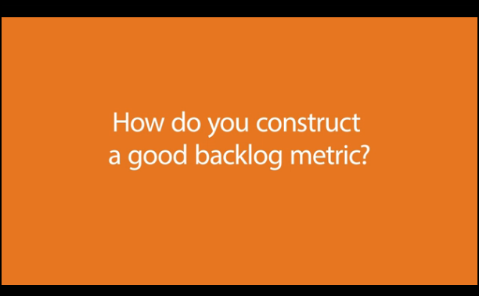
Testimonials
How do you construct a good backlog metric?
Notes:
SAY
These videos are available on HubConnect.
Thoughts, questions? What were some of the key points you heard during the video?
DO
After the video, close the video window to reduce use of system resources

Slide 61
What is a Backlog Idea and What is a Backlog Metric?
Backlog Idea
Backlog of Ideas
Backlog Metric
Is what you are going to do.
Created as part of your Business Opportunity and True North and is constantly updated and refined.
Needs to be fleshed out enough to measure the value they provide to the initiative.
Provides the measurement of the value provided by the Backlog Idea or group of ideas.

Slide 62
What are the Principles of Agile Funding Backlog Metrics?
Provides a measure of a Backlog Idea’s impact and contribution to value.
Must be tied to one or more True North Metrics.
Used to refine the backlog and identify the priority for each idea.
Contributes to the initial Agile Funding Rate for the initiative.
Measures progress while climbing the value mountain:
  All Backlog Ideas must have a clear measure that can be evaluated soon after implementation.
No Backlog Idea should be considered complete without the ability to measure its value when in production.
N

Slide 63
Initial Presentation of Backlog Metrics is Based on
What You Know Now
Optional for initial funding. Required for Execution Review:
Required, but not perfect:
Backlog Metric Information
Backlog Idea Description
Estimated Time to Complete
True North Metric
Estimated Cost
Backlog Metric to Measure Benefit
Estimated Payback Years
Prioritization
Net Present Value (NPV)
Internal Rate of Return (IRR)
Notes:
SAY:
Nice-to-have on right – we don’t want teams to think they need to get to this level initially. All are important.
Left is for initial funding request. Right is for execution review, however if the data is available it may be included for initial funding review to help set context.
For the NPV, I reworded that as well as the dollar amount returned by the formula isn’t exactly profit. It’s more like economic utility, where if the value is positive, the investment provides value to the company, and the higher the better, but it’s not a direct correlation. I.e. an NPV of $2,354,231 does not me that we receive $2.3M in incremental profit.
IRR (internal rate of return) is a financial metric used in capital budgeting to estimate the financial return of an investment. The resulting percent is the rate of return of the program, when the net present value of cash flows (both positive and negative) from the investment are equal to zero. This percent must be compared against a threshold and if it exceeds that threshold, the program is financially viable.
NPV (net present value) is another financial metric used in capital budgeting to estimate the financial return of an investment. The resulting dollar value is a measurement of potential profitability and is calculated by subtracting the present values of cash outflows, including initial cost, from the present values of cash inflows for a time period. If the resulting NPV is positive, the investment is financially viable.

Slide 64

Example of Product Backlog: eMBI
Idea # | Current Priority | Idea (Candidate/Feature/Need) | True North Metric | Backlog Metric | Mon. To Complete Idea | Backlog Phase (status) | Cost Projec- tion | NPV (in 000’s) | IRR | Payback Years (fin.)
1 | 1 | Provider Express Clinical Redesign (Quick Cert) – Phase 1 | OpsExp | Call handle time reduction 28 mins to 8 mins $4m opsexp savings because concurrent review time reduces by 40% | 6 | Dev. | $867 | $1,758 | 38.3% | 1.3
1 | 2 | Provider Express Clinical Redesign (Quick Cert) – Phase 2) | OpsExp NPS | Supports metrics from Phase 1 above. Both Phase 1 and Phase 2 are required. | 6 | Starts Jan.
8 | 3 | Resolve Linx A&G work arounds and root cause of current fines. Data is not transferred with the ICUE migrations so any state migrating to ICUE creates manual A&G work to rekey in Linx. Are being fined approx. 1.8m annually today. | OpsExp | Avoid 20% increase in fines approx. $360K annually (error reduction) Avoid 40% FTE increase approx. $2m annually This is all segments. Adjust for C&S Currently fined $1.8 m annually | 6 | Dev. | $860 | $1,846 | 245% | 1.4
64

Slide 65
Backlog Ideas vs. Backlog Metrics
Provider Express Clinical Redesign – part 1 reduced from 28 minutes to 14 minutes
Provider Express Clinical Redesign – part 2 reduced from 14 minutes to 8 minutes
Backlog Idea
Backlog Idea
Backlog Idea
Backlog
Idea
(Define done; Acceptance Criteria) – Required to complete
Backlog Idea
Backlog Idea
Backlog Idea
Backlog Idea
Backlog Metrics
(Measure Value, impact)
Size = effort.
$ = value
Backlog Metric
$$$
Call handle time from 28 minutes to 8 minutes- $4mm Ops Exp reduction
Backlog Metric
$$
Backlog Metric $
Notes:
SAY:
Some Backlog Metrics require multiple Backlog Ideas for implementation.
For example, you cannot directly measure the value of redesigning the checkout workflow. It is necessary complete all the Backlog Ideas in the example to realize the value of the Backlog Metric.
Backlog Idea – Each row is an idea. What the team wanted to do. Is composed of user stories and features
Backlog Item: (provider redesign – plenty of acceptance criteria, tangible and specific). Backlog Metric - How it aligns and what value you get from the Backlog Item.
During execution, the Backlog Idea evolves into a Backlog Item the team can execute against.
Feedback on how this is received. Questions it answers, questions it raises.

Slide 66

How Do We Show Progress to a True North Metric like NPS?
NPS
Is important
Measurable
Impossible to measure the direct contribution of an initiative to NPS score
How can we show progress?
Can state how a Backlog Metric is a driver to NPS.
Backlog Metric examples that drive NPS:
  Call handle time reduced from 28 minutes to 8 minutes resulting in a $4M Op Ex savings
  Reduce routing errors and miscommunication for front line & triage teams by ~10 minutes per day per person
  Reduce average time from 3.7 minutes to 1 minute resulting in $500k annual savings
There is a strong correlation between these Backlog Ideas and how the NPS score can be positively impacted, by improving our providers’ overall happiness.
Notes:
NOTE:
NPS also pulls in other variables, as it cannot be directly measured but able to make inferences. We will continue to use our knowledge and Provider SME’s to gauge how something should affect the NPS.

Slide 67
Case Study Activity

Slide 68
Case Study Inputs 1
You manage the call center for the Health Savings Account (HSA) business. Ten percent of the calls that come into the helpdesk are driving 40% of the cost. If you can figure out a way to decrease the call time for the longest calls, you can drive significant expense reduction in your area.
Initial analysis of the calls indicates that the majority of the long calls have the following characteristics:
Call topics required the agent to perform extensive searches through a SharePoint site of unstructured, unindexed, and uncategorized documents.
Agents with less than a year experience were twice as likely to have long calls than agents that had been there over a year. Currently, all agents work out of the same queue, regardless of experience level.
Current Landscape
Average call length is 10 minutes, with 90% of the calls lasting less than 15 minutes.
The remaining 10% of the calls range from 15 to 45 minutes.
Expense break-down
Every call costs $2 per minute.
User counts
Each weekday the call center handles 3,000 calls.
Your mission
You have 10 minutes.
List on your flipchart potential Backlog Ideas and Metrics.
Notes:
SAY:
You have 10 minutes and a flipchart for your table.

Slide 69
Case Study Inputs 2
Your business segment has identified a new opportunity within the Employer Paid health plans market. Employers want to track the effectiveness of their campaigns to encourage employees to exercise. The exercise campaign will be conducted by a third party, but the employers want an independent party to track their engagement rates using data uploaded from wearable devices.
The business segment has done market research and found an emerging opportunity based on leveraging existing fitness apps, e.g., “Map My Run,” to pull data and aggregate them into a single portal.
This approach provides quick speed to market and low initial investment.
The disadvantage is long term support costs as constant updates to the aggregation system are required to keep up with changes in the third party fitness apps.
Current Landscape
25 large employers have shown willingness to pilot this program, but only if the first six months are free.
Profit Margin
Employers are willing to pay around $2-$5 per member per month.
User counts
The 25 employers interested in the pilot average 3,000 employees each.
Your mission
You have 10 minutes.
List on your flipchart potential Backlog Ideas and Metrics.
Notes:
You have 10 minutes and a flipchart for your table.

Slide 70
Case Study Recommendations
  Your mission:
  List on your flipchart potential Backlog Ideas and Metrics.
Table 1
Table 2
Table 3
Table 4

Slide 71
Agile Funding Rate
40 minutes

Slide 72
Agile Funding
You are here
(0-3 month launch)
(Every 3-9 months)
Initial Funding Review
Execution
Review
Pre-funding
Preparation
Agile Delivery
EXIT
EXIT
Notes:
SAY:
This workshop is about the first part of the bottom image, from 0-3 months, and the last part (execution reviews) every 3-9 months.
Initial Funding Review: Capital committee evaluates proposal and decides whether to fund
Executive Review: Capital committee evaluates initiative performance, AND Continue, change funding level, or end
The middle part, referred to as the hamster wheel, we know how to do…this is the Agile process where Scrum teams are working on the backlog items and delivering value.
It’s important that the execution teams/Scrum teams remain aware of the Agile Funding True North Metrics and Backlog Metrics so that they can figure out ways to measure progress and get ready for those execution reviews

Slide 73
Agile Funding Process – Determine Agile Funding Rate
Define Business Opportunity
Prepare Backlog Ideas and Metrics
Identify True North Metrics
N
Value
Determine Agile Funding Rate

Slide 74
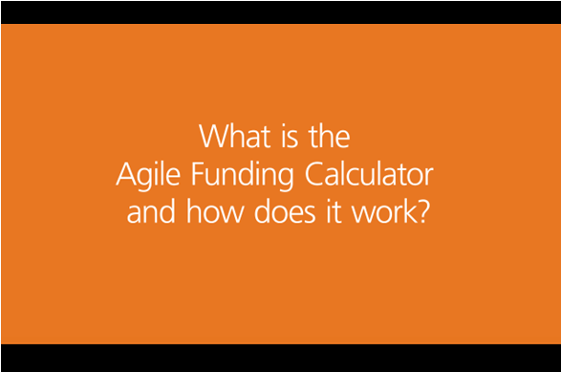
Testimonials
What is the Agile Funding Calculator and how does it work?
Notes:
SAY
These videos are available on HubConnect.
Thoughts, questions? What were some of the key points you heard during the video?
DO
After the video, close the video window to reduce use of system resources

Slide 75
Roles and Responsibilities
Finance
Partners with Program Leadership team to populate the Agile Funding Calculator (Bruce Gustafson is the owner)
Answers questions related to the inputs and outputs of the Agile Funding Calculator
Capital Committee
Reviews the business and technology teams’ Business Opportunity, True North Metrics, and Backlog Ideas
Approves, rejects, or adjusts the proposed Agile Funding Rate at each review
Sets the next Execution Review date
Assesses future funding rate based on performance at Execution Reviews
Business and Technology Team
Presents the Business Opportunity, True North Metrics, and Backlog Ideas
Determines if there are necessary up-front or ongoing costs (e.g., hardware, license, software)
Recommends the proposed Agile Funding Rate based on multiple factors (e.g., Agile Funding Calculator, realistic teaming)

Slide 76
Agile Funding Addresses Risk, Reality, and Uncertainty
  Risk
Reality
Uncertainty
01
02
03
Agile Funding flips the financial evaluation from determination of financial returns based on estimated costs and benefits to a calculation of investment ranges based on risk adjusted benefits.
Riskier investments are discounted more heavily.
The initial rate is determined by accounting for the realistic rate at which the team can efficiently and effectively allocate capital and resources.
The future rate is adjusted based on actual results.
Reviews funding rate at 3-9 month intervals based on performance against Backlog Metrics rather than at annual intervals.
Embraces the fact that we don’t know everything now, but we know enough to get started.
Notes:
SAY:
When you receive the funding, a date will be set for another Capital Committee meeting.
You can schedule time with the Capital Committee at any time if you realize a larger value and need additional funding or you want to cancel the project.

Slide 77


Traditional CBA vs. Agile Funding (BCA)
Starts with estimated costs that are justified with estimated benefits
Often requires upfront commitment to projected benefits (e.g. headcount reduction).
Team manages cost and approved scope once total or annual funding is determined
Benefits delivery not always measured, evaluated or factored into continued funding.
Funding evaluated annually, usually based on remaining scope and cost.
Starts with potential value and then determines how much we should spend now.
Uses Agile Funding Calculator initially to apply risk adjustments to benefits projections with commitment to regularly report actual benefit delivery.
Teams align work to the benefit streams (True North) and dynamically adjust the backlog (scope) based on actual results and learning.
Teams measure results and value delivery at regular intervals.
Level of spend adjusted every 3-9 months based on Actual Value Delivered.
Agile Funding
Notes:
A CBA is cost benefit analysis.
Both are based on estimated (i.e. guesses based on assumptions) benefits. The difference is in traditional, you start with cost and justify it with benefits. In Agile funding, you determine the potential value (benefits), then estimate what you are willing to spend to get a satisfactory return on investment.
In traditional funding you develop a CBA to identify projected benefits to justify how much you are spending. In a CBA you start with a bottom-up of the COST, then go looking for estimated benefits to justify the investment. Once the funding is approved, the team manages the COST, and the benefits aren't usually evaluated. As long as they stay within BUDGET, their funding is not at risk. The real benefits aren't usually measured, evaluated or factored into future funding. Most programs either deliver their scope against their original budget, or come back to ask for more money when their scope changes or they run out of budget and still aren't done.
In Agile Funding, it is a similar kind of analysis up front, but backward. It is concerned primarily with BENEFITS. You identify the benefit streams, then use those to determine what you might be willing to spend. Using the Agile Funding Calculator, you build in a lot of risk adjustments to the benefits assumptions to recognize the fact that you are just guessing, predicting the future, and completely wrong - it is just a question of by when and by how much.
In Agile Funding teams then align their work to go after those benefits streams, then go about creating and demonstrating value, and the level of spend is adjusted up or down every 3-9 months based on ACTUAL RESULTS. If the team delivers more value than they estimated and has a backlog that has higher future benefits identified, they can ask for a higher funding rate to go after those benefits. If they deliver less value than expected, their funding could be reduced or cancelled and those funds applied elsewhere to better investment opportunities. Unlike traditional funding, the benefits are measured and evaluated at regular intervals, and the rate of spending is adjusted.

Slide 78
Agile Funding Rate - Inputs
Agile Funding Calculator
Agile Funding Rate
(Gift Card) Recommendation
Realistic Team Staffing Strategy
Capital Planning Placeholder
Risk Profile
78
Notes:
SAY:
Calculator provides a rate but it is only one aspect of the decision.

Slide 79
Agile Funding Rate - Review Frequency
Funding Review Frequency Considerations:
Standard Execution Review cycle (3-9 month)
Overall risk profile
Time to Minimum Viable Product (MVP)
Backlog Latency
Backlog Latency is the months from the beginning of initial development to start of benefit capture.
For example: If the same program took 12 months to build but started receiving some benefit 6 months into development, it would have a backlog latency of 6 months.
Notes:
SAY:
Risk Profile: (more risk = faster review)
NOTE:
Should the funding review frequency schedule align to PI (Agile Schedule). It may align to PI (Agile Schedule) but may not. No extra benefits to align it.

Slide 80
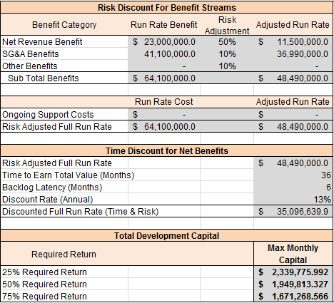
Agile Funding Calculator – General Inputs
Net Revenue Benefit - Revenue run rate benefit received after associated direct costs are removed.
SG&A - Benefits associated with FTE's (full-time equivalent) and Non-FTE SG&A saves. These benefits are reduced by the calculator to account for historical benefit degradation. Do not adjust these values in the calculator.
Other Benefits - All remaining hard benefits not associated with net revenue or SG&A.
Time To Earn Total Value (Months) - Months from the beginning of initial development until full run rate benefit capture.
Backlog Latency (Months) - Months from the beginning of initial development to start of benefit capture.
Discount Rate (Annual) - Corporate standard discount rate utilized in the CBA and other financial tools.
Required Return - Amount of a return on investment needed to justify spending the capital.
Notes:
SAY:
Time to Earn Value example: For example: A program that takes 12 months to build and another 12 months for the benefits to reach a full run rate, the time to earn total value would be 24 months. NOTE: Risk reduction is baked into the calculation, etc)
Backlog Latency example: For example: If the same program took 12 months to build but started receiving some benefit 6 months into development, it would have a backlog latency of 6 months.
Net Revenue Benefit : For example: I.E. $100M in gross revenue – $85M direct costs (COGS like costs) = $15M in Net Revenue. These benefits are adjusted to account for historical benefit degradation, do not edit.
Example: If you want a 75% rate of return, the team should not be funded MORE than $1.67M per month.

Slide 81
Agile Funding Rate Example: eMBI
Note: Current 2017 Capital Allocation is $9m
Risk Discount for Benefit Streams
  Payer Revenue increase of 5% ($23m) annually
  Operation Expense reduction of 7% ($41m) annually
  Benefit Expense reduction of 3% (not quantified)
  Consumer NPS
Time Discount for Net Benefits
  36 months (similar ramp associated with each value category)
  6 months backlog latency
Total Development Capital
  $1.67m per month @ 75% return
  $500k per month 2017 / July check point
    Realistic product owner and analyst staffing Realistic IT staffing ramp plan Q1 2017
    Prove benefit in 2017 to affect run rate then adjust
Notes:
SAY:
Some projects will have one time costs for hardware, software, licenses, etc. Factored into rate. Concept of gift card.

Slide 82
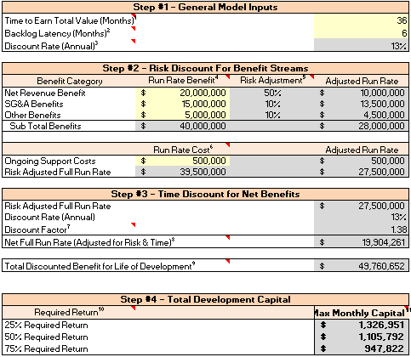
Activity: Agile Funding Rate
Assumptions:
Current Annual Capital Plan Placeholder: $8MM
$120K / month per team
20 ideas in backlog with a potential value of $25MM
Two existing teams are ready. They can deliver the top four Backlog Ideas in 5-6 months with a combined potential value of $4MM.
Each additional team will take 1-2 months to onboard before they are fully able to add value against the backlog.
Your Mission:
How many teams would you fund?
Why?
What funding rate would you need to support the teams?
15 min
Notes:
SAY:
Some projects will have one time costs for hardware, software, licenses, etc. Factored into rate. Concept of gift card.
Gift card is for 6 months

Slide 83
Case Study Recommendations
  Your mission:
  How many teams would you fund?
  Why?
  What funding rate would you need to support the teams?
Table 1
Table 2
Table 3
Table 4

Slide 84
Agile Funding Fundamentals Execution Preview
20 minutes

Slide 85
Agile Funding Model
You are here
(0-3 month launch)
(Every 3-9 months)
Initial Funding Review
Execution
Review
Pre-funding
Preparation
Agile Delivery
EXIT
EXIT
Notes:
Two phases:
Two milestones:
Initial Funding Review: Capital committee evaluates proposal and decides whether to fund
Executive Review: Capital committee evaluates initiative performance, AND Continue, change funding level, or end

Slide 86
Agile Funding Execution Process
Business Leadership determine Backlog Items to fund
Time for a capital review?
Sprints
Value
Evaluate outcome of sprints, refine backlog based on results

Slide 87
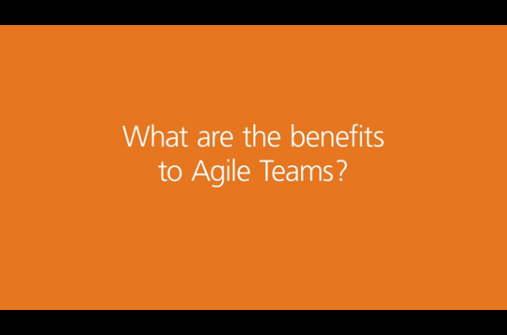
Testimonials
What are the benefits to Agile Teams?

Slide 88
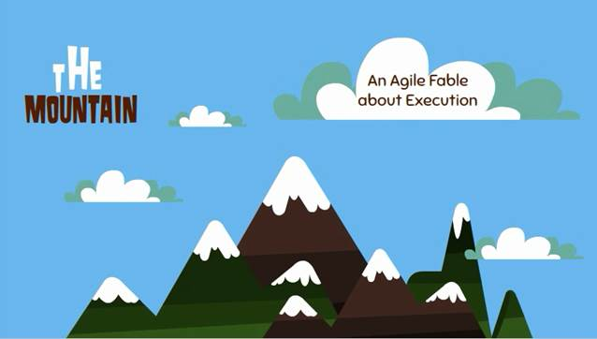
The Mountain

Slide 89
Agile Funding Governance
Traditional Funding
Approves Total Funding Request
Approves Requirements Analysis
Approves Scope and Approach
Reviews/Approves Change Requests
Capital Committee
$$$
Agile Funding
Approves Business Opportunity and True North Goal
Approves Monthly Agile Funding Rate
Reviews Value Delivered and potential Backlog Ideas at each Execution Review
Approves continuation, change, or cancellation of funding
Notes:
SAY:
We normally function as “side of desk” [side of the desk = part-time business involvement]. As a project manager, we only spend 25% of the time on the project. With Agile you need someone dedicated. It’s a change management piece that Agile projects need more funding.
The role of the capital committee in Traditional Funding is to approve the entire project. In Agile funding the role is much different. They are approving your true north and your funding rate – that’s it. At the review, the capital committee approves any change of direction, any change in funding rate, or kills off the project (maybe it isn’t providing value, or maybe it has completed it’s ability to provide value!).

Slide 90
Agile Funding Governance (continued)
Traditional Funding
Meet the approved scope within the approved budget
Measures project delivery (scope, cost, time)
Submits change requests as needed
Business and Technology Team
Agile Funding
Owns the scope (add, change, or cancel Backlog Ideas)
Measures value created via Backlog Metrics
Recommends funding changes based on progress and learning
Notes:
SAY:
Very important: The business team owns the backlog of ideas, not IT. The backlog of ideas is not limited to technical solutions.

Slide 91
Backlog Ideas Evolves into Backlog Items
Idea # | Current Priority | Idea (Candidate/Feature/Need) | True North Metric | Backlog Metric | Approved Investment | IT Actuals (as of 12/31) | NPV | IRR | Deployment Date | Backlog Phase (Status)
1 | 1 | Auto load accumulator related transactions in TOPS vs. manual intervention. | Reduce Refund Checks | Reduce # of refund checks (5K) Operational Savings of $1.6M over 5 years Reduction in Accumulator Transaction Errors | $360K | $140K | $486 | 86% | Aug. 2016 | Complete
2 | 2 | Correctly calculate members YTD balance when a medical transaction is received before a pharmacy transaction is processed. | Improve Member Experience | Reduce # of refund checks 10 % reduction in number of members that are out of balance Reduction in Accumulator Transaction Errors | $240K | $77 | ($140) | N/M | N/A | Cancelled
3 | 3 | Analysis to standardize field formats across all internal claims systems. | Reduce Operational Costs | Reduce operational errors and manual work Proactive member identification and corrective action | $80K | $38K |  |  | N/A | Cancelled
15 | 4 | Implement Operational Process Improvements and Controls to Reduce # of Benefit setup issues between TOPS and Rx. | Reduce Refund Checks | Reduce Refund Checks Improve Member Experience | $0 | N/A | $35 | 96% | TBD (de-prioritized) | On Hold
Notes:
During Execution, a Backlog Idea Evolves into Backlog Items that a Team Can Execute Against

Slide 92
eMBI
Execution Summary Dashboard
 | True North Metric | Since Last Review |  | Since Inception (Jan) |  | Cumulative Results (3 yrs)
 |  | One Time | Recurring | One Time | Recurring
Spend | Total |  |  | $1,961,430 | $0
Backlog Summary
Ideas implemented | 8
Scheduled for implementation (in development) | 4
Approved pending initiation | 5
Cancelled / Stopped / Merged | 16
Under Evaluation based on cost, risk, return | 36
Total | 69
Benefits | Increased Revenue |  |  |  |  | $0
 | Reduced OpsExp |  |  |  | $2.4m | $7.2m
 | Reduced BenExp |  |  |  | $3m | $9.0m
 | Totals |  |  |  | $5.4m | $16.2m
In addition to the 8 deployed ideas, 4 prioritized ideas are on target for Q3.
With completion of these 4 ideas, the program will provide an additional $2.1m OpsExp savings and reduce AHT
Financial Performance
Current IRR Based on ideas implemented | 79%
NPS
Team believes 5 of 8 deployed ideas have positive NPS impact
Prioritized Ideas | Current AHT | Future AHT | Actual Results | Reduction | Comments
Portal TMA initial authorization Provider Portal TMA Initial authorization Advocate Portal TMO subsequent authorization Provider Portal TMO subsequent authorization Advocate Provider Telephonic TMA request Provider Telephonic TMO request Properly Route IVR Alerts Integration w/ICUE | 28 mins 14 mins 20 mins 15 mins 8 mins 15 mins | 8 mins 4 mins 8 mins 9 mins 4 mins 10 mins | 3 mins 8 mins 8 mins 7 mins TBD TBD | 89% 42% 60% 53% | Deployed Deployed Deployed Deployed Deployed Deployed Deployed Deployed
Being finalized
$3M BenEx
4

Slide 93
eMBI
True North Results To Date
 | True North Metric | Since Last Review |  | Since Inception (Jan) |  | Cumulative Results (3 yrs)
 |  | One Time | Recurring | One Time | Recurring
Spend | Total |  |  | $1,961,430 | $0
Benefits | Increased Revenue |  |  |  |  | $0
 | Reduced OpsExp |  |  |  | $2.4m | $7.2m
 | Reduced BenExp |  |  |  | $3m | $9.0m
 | Totals |  |  |  | $5.4m | $16.2m
In addition to the 8 deployed ideas, 4 prioritized ideas are on target for Q3.
With completion of these 4 ideas, the program will provide an additional $2.1m OpsExp savings and reduce AHT
NPS
Team believes 5 of 8 deployed ideas have positive NPS impact
4

Slide 94
eMBI
Backlog Performance To Date
Backlog Summary
Ideas implemented | 8
Scheduled for implementation (in development) | 4
Approved pending initiation | 5
Cancelled / Stopped / Merged | 16
Under Evaluation based on cost, risk, return | 36
Total | 69
Financial Performance
Current IRR Based on ideas implemented | 79%
4

Slide 95
eMBI
Deployed Backlog
Prioritized Ideas | Current AHT | Future AHT | Actual Results | Reduction | Comments
Portal TMA initial authorization Provider Portal TMA Initial authorization Advocate Portal TMO subsequent authorization Provider Portal TMO subsequent authorization Advocate Provider Telephonic TMA request Provider Telephonic TMO request Properly Route IVR Alerts Integration w/ICUE | 28 mins 14 mins 20 mins 15 mins 8 mins 15 mins | 8 mins 4 mins 8 mins 9 mins 4 mins 10 mins | 3 mins 8 mins 8 mins 7 mins TBD TBD | 89% 42% 60% 53% | Deployed Deployed Deployed Deployed Deployed Deployed Deployed Deployed
4

Slide 96
When Do We Need an Execution Review?
When we need to review funding:
Next scheduled Capital Committee review set at the Initial Funding Meeting
When we learn that we need to make a change
Deliver value faster
Exhausted backlog
Need to react to a change in business conditions
When is it time to stop
It makes more sense to spend good money elsewhere

Slide 97
High Level Process
Idea
Business Opportunity
True North
Roadmap
N
True North Metrics
Product backlog
Backlog Ideas and Backlog Metrics
Capability/
Feature DOR
Sprint backlog
Reporting Metrics and Execution Reviews
Working product
Daily stand ups
User Story DOR
Sprints
User Story DOD
Production Release and Warrantee
Sprint Demo and Acceptance

Slide 98
Example: Agile Funding Fundamentals Overview
Problem Statement
Today, client commitments & requirements information are housed in line-of business or product-specific repositories with limited integration across systems. Also, there is no single client identifier across Optum thus making it difficult to get a holistic view of a client across all of Optum’s products and services. These shortfalls result in fragmented client experience as they interact with each supporting area across Optum thus impacting Optum’s overall ability to support rapid growth, including cross line-of-business deals. Program Description: Client Source of Truth is the critical foundation needed to support the lifecycle of our clients by knowing who they are, what they have purchased and our commitments to them. This program is creating a cross-Optum reference source for client commitments, requirements and single client identifier across Optum.
 | Business Opportunity | True North | True North Metric
Before | Increase customer intimacy and link information across the enterprise through a comprehensive and accurate understanding of the sales, fulfillment and support touchpoints with ease and support the building blocks for a strategic enterprise. | Drive towards 100% of functional areas data availability being accessed via CSOT Increase customer retention/renewals by X% Increase reliability and accuracy of client level data by X% Increase ease of access by information by X% Cost Avoidance ($22MM) | Use functional areas, determine ability to move across Clemments / Geof obtain by product family? Lowest level Initial user survey degree of confidence, at end re-ask Initial user survey degree of satisfaction of ease of access, at end re-ask Cost for: cMDM core build, onboarding data sources, and other program avoidance variables
 | Business Opportunity | True North | True North Metric
After | Increase customer and employee satisfaction and support the building blocks for a OneOptum enterprise by improving management of and access to comprehensive, accurate client information. | Decrease latency of data access requests Cost Avoidance of building multiple similar solutions Key Driver of NPS- Expectations are met Decommission applications Number of clients for which we have holistic client profile Foundation to build operational processes Client configurator reduces manual handoff and accuracy Growth – how upsell, client knowledge | From over 60 minutes per client to under 10 From over 22 M to 7M Working with Matt Larson Working with Shiraz Baseline 0
Notes:
1.Decrease latency of data access requests
What do for organization?
Will work on next 2-3 years?
How narrow down and not hunt all over the place??
WHY? Business outcome will this drive?
2.Cost Avoidance of building multiple similar solutions
3.Key Driver of NPS- Expectations are met
Can improve overall experience?
4.Decomission applications
5.Number of clients for which we have holistic client profile
Foundation to build operational processes
Client configurator reduces manual handoff and accuracy
Growth – how upsell, client knowledge, …
#1 client rig, has to have holistic profile, different ways to approach; learning from #! And now how to go about more strategically.
What does it do for organization? And so what? Why care? Benefit and bottom line?
Art vs. Science when creating these. Need to articulate the “why” behind. Everyone on program need to know these TNM and how to further unlock opportunities against these
1.From over 60 minutes per client to under 10; how quantify the hard benefits? How know making progress? What is impact?

Slide 99
Agile Funding Fundamentals Conclusion
55 minutes

Slide 100
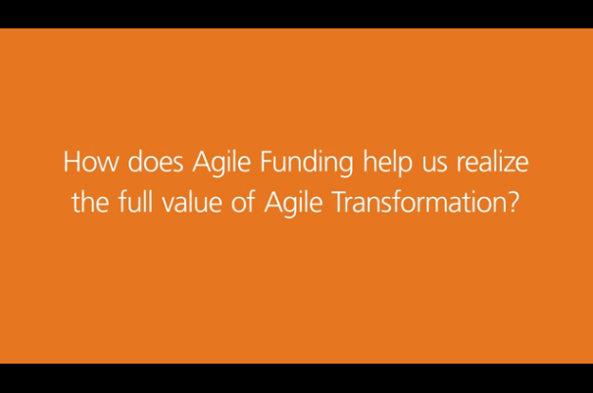
Testimonials
How does Agile Funding help us realize the full value of Agile Transformation?
Notes:
SAY
These videos are available on HubConnect. .
Thoughts, questions? What were some What were some of the key points you heard during the video?
Juan’s probing questions when it was slide 6:
What are your initial reactions?
What are some questions you have right now? (don’t answer them now but answer them as we go through the course)
Can you relate to Connly's comments about knowing what we do in July and August will enable and give us learnings to what we need to build in September? (agreements/disagreements?)

Slide 101

We've Only Just Begun

Slide 102
Final Assessment
Using any web browser, respond at PollEv.com/agilefunding
This helps us understand what you learned and how successful the course was so we can improve future sessions.
Notes:
SAY:
The same 24 questions that you completed earlier are in this survey. You have 10 minutes.
You can take the poll from your PC or smartphone. For either, enter the PollEV.com/agilefunding link in the browser.
You are taking this poll to help us assess the effectiveness of this workshop

Slide 103
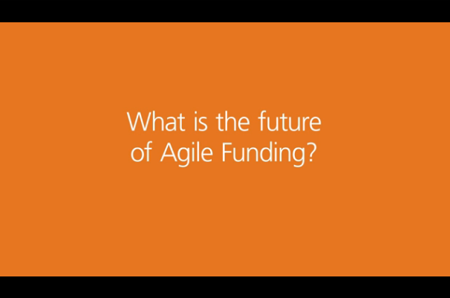
Testimonials
What is the future of Agile Funding?
Notes:
SAY
These videos are available on HubConnect.
Thoughts, questions? What were some of the key points you heard during the video?

Slide 104
Our Next Steps
High priority Backlog Ideas that we are working on:
Additional Agile Funding Workshops
Upcoming Backlog Ideas:
Minneapolis: (3) Sept. – Oct.
Fundamentals workshops
Connecticut: TBD
Fundamentals workshop
Boston, Chicago, New Jersey: Oct – Nov.
Fundamentals workshop
Execution Workshops
Develop executive education material
Develop rollout/operational strategy
Develop persona-based learning strategy
Continue to build out content on Hub Connect
Artifacts and Templates
Continued improvements to Agile Funding Fundamentals workshop based on feedback
Continue to build video content to fill gaps (Execution challenges and lessons learned, Agile Funding Rate, and Agile Funding Calculator role)
Develop Agile Funding Execution launch workshop
Develop tools for Agile Funding teams to “pay it forward”
Notes:
NOTE:
Backlog ideas are prioritized.
Highest priority
Execution workshop
Executive education
Rollout/Ops strategy
Persona-based learning paths

Slide 105
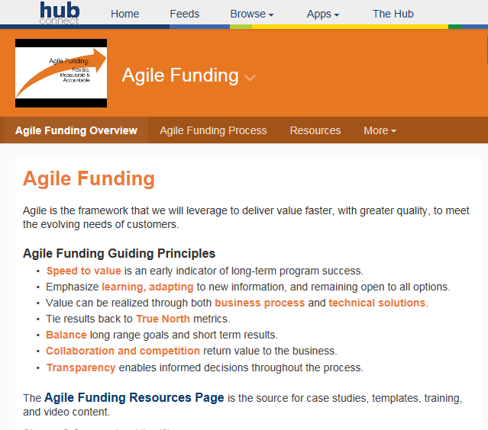
Call to Action!
You are here because your leadership team nominated you
Be a change agent
Help educate others on Agile Funding
Encourage others to sign up or to learn more
We are developing tools for Agile Funding teams to “pay it forward” and we’ll need your help (testimonials, examples, lessons learned, etc.)
Leverage the resources on Hub Connect, ask questions in the community forums, follow it to get updates
https://hubconnect.uhg.com/groups/agile-funding

Slide 106
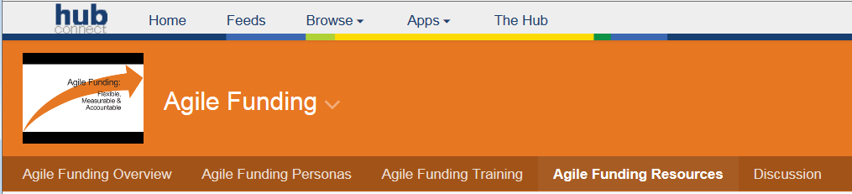
Support Resources
Agile Funding Hub Connect Resources page URL: http://goto.uhc.com/wbt/AgileFundingHC
Resources include:
PowerPoint decks and other materials from Agile Funding Fundamentals and Agile Funding Execution Overview workshops
Testimonial and Fable videos shown in Agile Funding workshops
PowerPoint decks from case study initiatives discussed in Agile Funding workshops (eMBI, Accumulators, etc.)
Glossary of Agile Funding terms
Frequently Asked Questions

Slide 107
Key Contacts and Agile Coaches
HubConnect url:
Key Contacts and Agile Coaches:
Tom Ely (Solution Delivery Management)
Larry Beardman (Solution Delivery Management)
Ken Mair (Solution Delivery Management)
Juan Colon (Solution Delivery Management)
Bruce Gustafson (Finance)
Sean O’Neill (Enterprise Architecture)
Kati Purfeerst (Solution Delivery Management)
YOUR NAME HERE
https://hubconnect.uhg.com/groups/agile-funding

Slide 108
NPS Evaluation
Using any web browser, respond at PollEv.com/agilefunding
How likely are you to recommend this event to a friend or colleague?
Why did you choose that response?
Retrospective: What went well? What could be improved?
Notes:
SAY:
You can take the poll from your PC or smartphone. For either, enter the PollEV.com/agilefunding link in the browser.

